Slide 1




Web Framework Programming
Topic 8
Submission Form
WEEK 08 Informatics Engineering
Universitas Surabaya
Informatics Engineering | Universitas Surabaya
Notes:
Cover Half
Gambar vector bisa didownload di: https://scale.flexiple.com/illustrations/
Jika ingin foto free royalty bisa download di: https://pixabay.com/photos/

Slide 2
Submission Data
https://laravel.com/docs/10.x/eloquent#inserts
Informatics Engineering | Universitas Surabaya

Slide 3
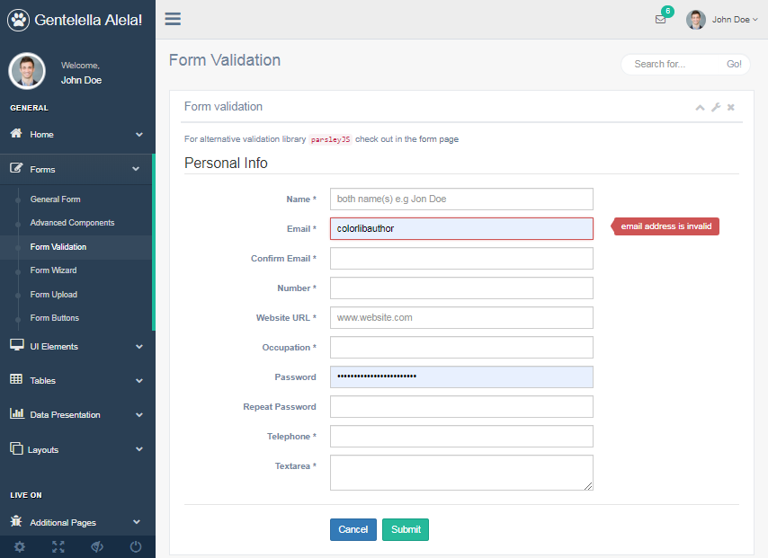
UI/UX provided for the required data
Not all field are provided for user input.
Some fields maybe are auto increment
Some fields are maybe are taken from session
Some fields maybe are not this user authority
Informatics Engineering | Universitas Surabaya

Slide 4
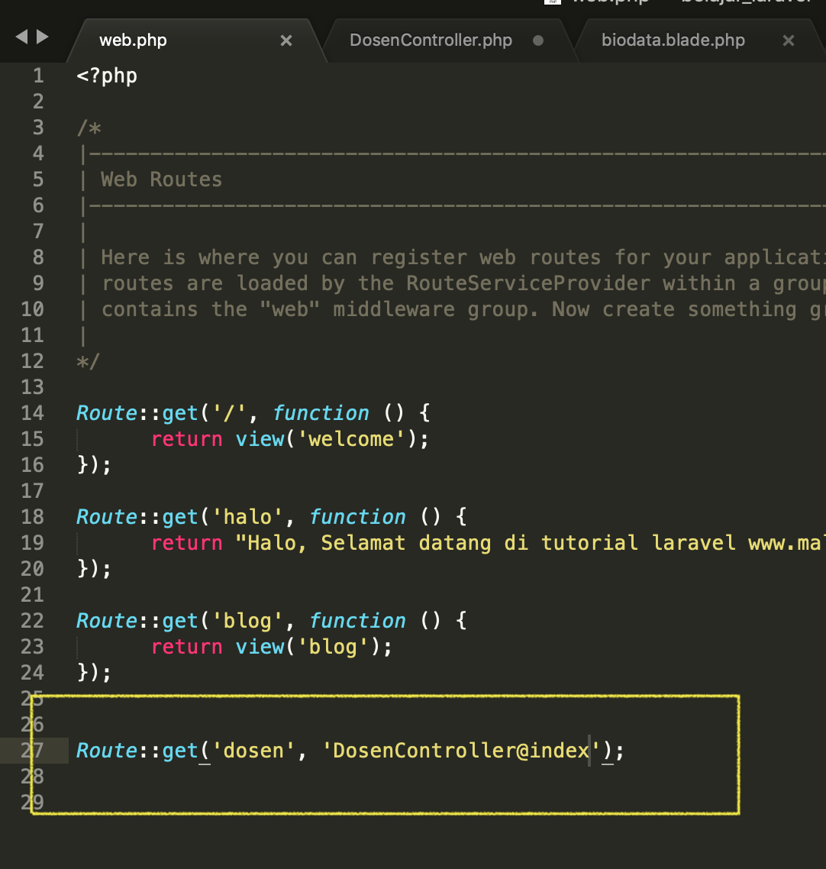
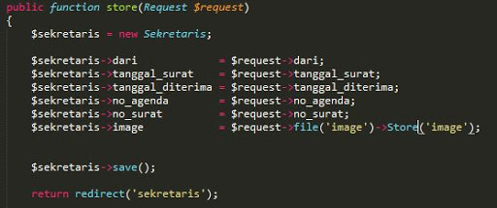
Example – Validation & Submission Process
Informatics Engineering | Universitas Surabaya

Slide 5
Exercise #1 : Creating Form
Informatics Engineering | Universitas Surabaya

Slide 6
Example - Bootstrap Form
<form>
<div class="mb-3">
<label for="exampleInputEmail1" class="form-label">Email address</label>
<input type="email" class="form-control" id="exampleInputEmail1" aria-describedby="emailHelp">
<div id="emailHelp" class="form-text">We'll never share your email with anyone else.</div>
</div>
<div class="mb-3">
<label for="exampleInputPassword1" class="form-label">Password</label>
<input type="password" class="form-control" id="exampleInputPassword1">
</div>
<div class="mb-3 form-check">
<input type="checkbox" class="form-check-input" id="exampleCheck1">
<label class="form-check-label" for="exampleCheck1">Check me out</label>
</div>
<button type="submit" class="btn btn-primary">Submit</button>
</form>
https://getbootstrap.com/docs/5.0/forms/overview/
Informatics Engineering | Universitas Surabaya

Slide 7
Create – a New Category
In this example, user can create a new category with a form.
Make sure :
You already have Category’s Controller and Model
Make sure you already create a table for model
Step :
Prepare a routing
Create a new file view with html form
Informatics Engineering | Universitas Surabaya

Slide 8
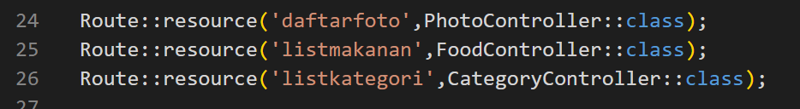
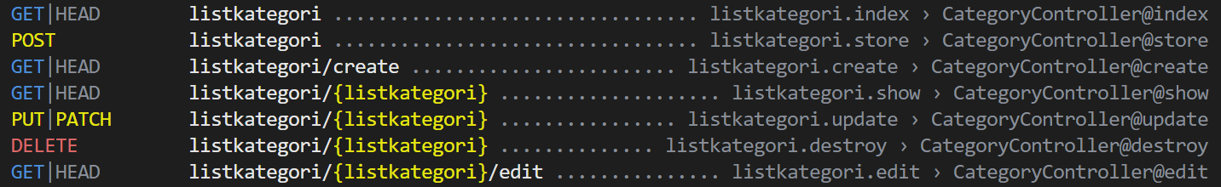
Prepare a Routing
Open web.php and check a new routing called listkategory (line 26).
Note: Review Routing Topics in Week 2-4
The implication of ‘route resource’ can be displayed at this syntax
Informatics Engineering | Universitas Surabaya

Slide 9
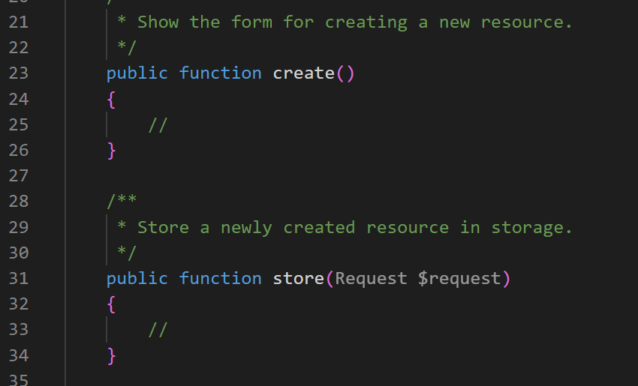
Prepare a Routing (2)
In KategoryController you will see :
Informatics Engineering | Universitas Surabaya

Slide 10
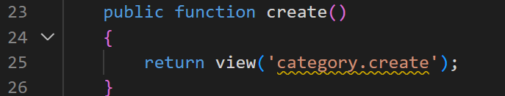
Create method() inside your Controller
The create() function shows the form to create a new Type data.
If the form must collect other data from other tables, you can construct the query statement before the “return view” statement and parse it.
This is a simple example of our case study (Type Form)
This method will direct into directory /resources/views/category and formcreate.blade.php file.
The name of ‘formcreate.blade.php’ is depends on analysis and naming file of your company
Informatics Engineering | Universitas Surabaya

Slide 11
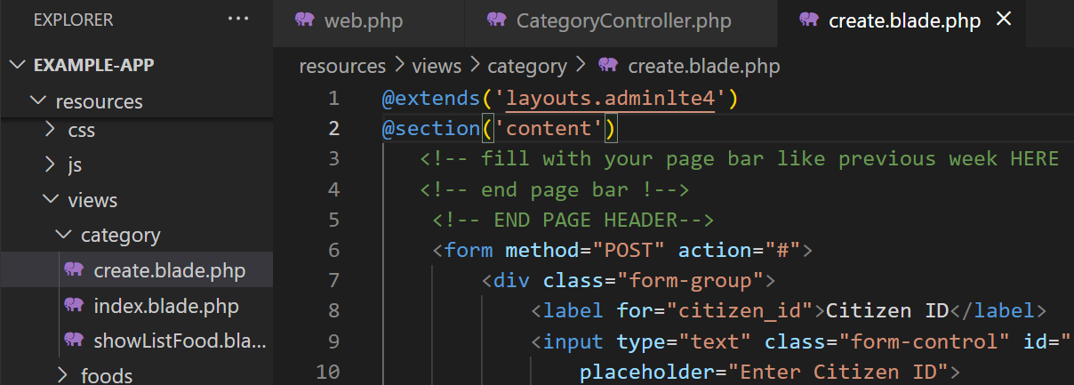
Create a New View : category/formcreate.blade
Put the file view in the folder category.
Implement your include, extend and section of your template
Implement your form create based on the bootstrap form.
Modify the form according to your database
Informatics Engineering | Universitas Surabaya

Slide 12
Create a New View : category/formcreate.blade (1)
@extends('layouts.adminlte4')
@section('content')
<!-- fill with your page bar like previous week HERE !-->
<!-- end page bar !-->
<!-- END PAGE HEADER-->
<form method="POST" action="#">
<div class="form-group">
<label for="name">Name</label>
<input type="text" class="form-control" id="name" name="name" aria-describedby="name"
placeholder="Enter Category Name">
<small id="name" class="form-text text-muted">Please write down Category Name here.</small>
</div>
<button type="submit" class="btn btn-primary">Submit</button>
</form>
@endsection
Informatics Engineering | Universitas Surabaya

Slide 13
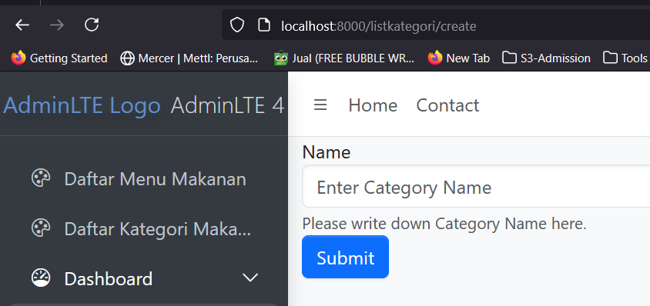
Test your view
Test your creation form by accessing from browser with this URL 🡪 {{BASEURL}}/listkategori/create
Informatics Engineering | Universitas Surabaya

Slide 14
Exercise #2 : Saving Data into DB
Informatics Engineering | Universitas Surabaya

Slide 15
Button Submit
In the form, an element with type=“Submit” will trigger an action or processing the form data
The process is directed to a method in a Controller.
Which inside `Resource Controller`, it already provided with the store() method.
Informatics Engineering | Universitas Surabaya

Slide 16
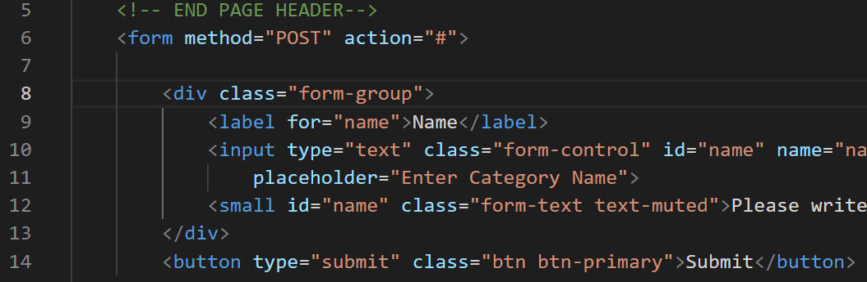
Defining Target Action
We need to define action with a target URL.
In order to connect with the store() method, we have to follow the convention of Resource Controller
Informatics Engineering | Universitas Surabaya

Slide 17
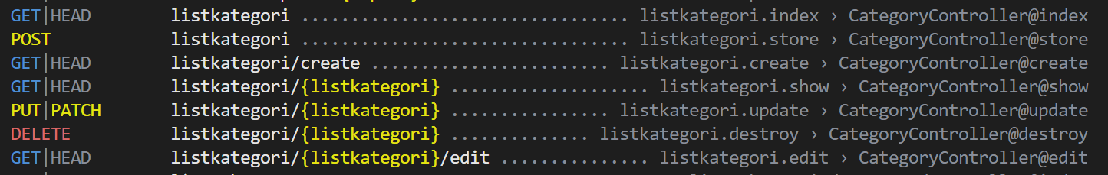
Defining Target Action (2)
Check the list of routes 🡺 php artisan route:list,
(1) what is the URL or the route name
(2) what HTTP method used to get into store() / CategoryController@store method
It shown that it need a POST method and has a route name = “listkategori.store” or url = “listkategori”
Informatics Engineering | Universitas Surabaya

Slide 18
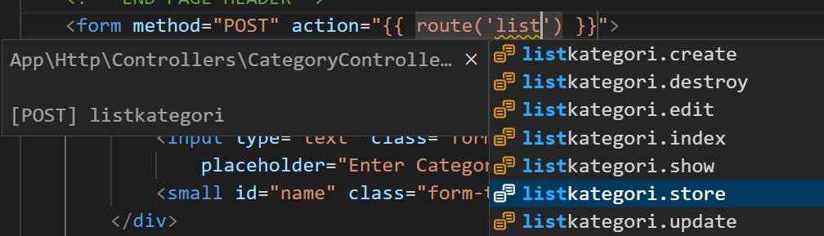
Defining Target Action (3)

Slide 19
Defining Target Action (3)
Therefore, the action parameter in the form is filled with :
OR
Informatics Engineering | Universitas Surabaya

Slide 20
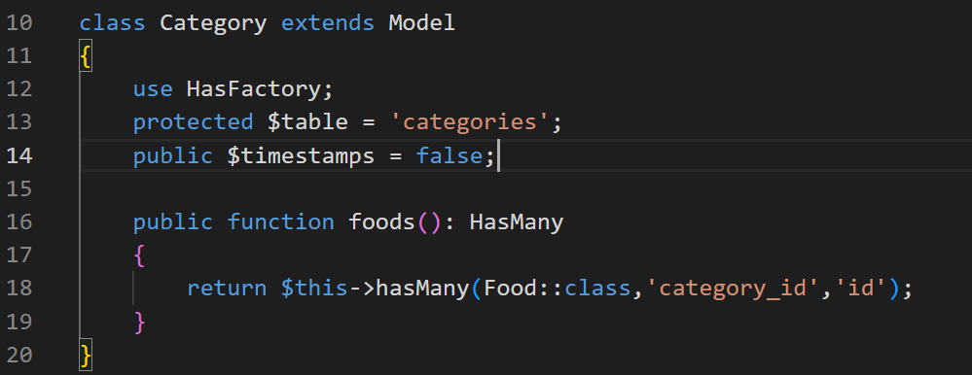
Check Convention
Check whether the your table already follows the convention or not.
If your Category table doesn’t have “created_at” and “updated_at” fields, you need to do an overriding to the timestamp field (see the image) .
Informatics Engineering | Universitas Surabaya

Slide 21
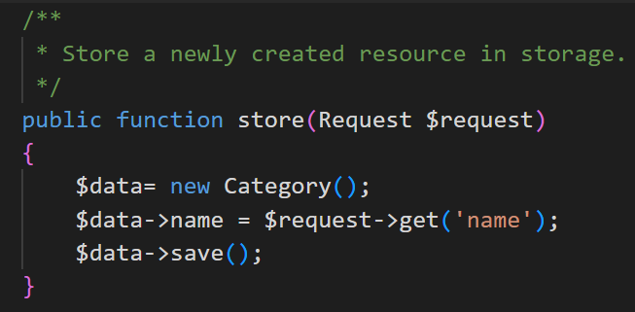
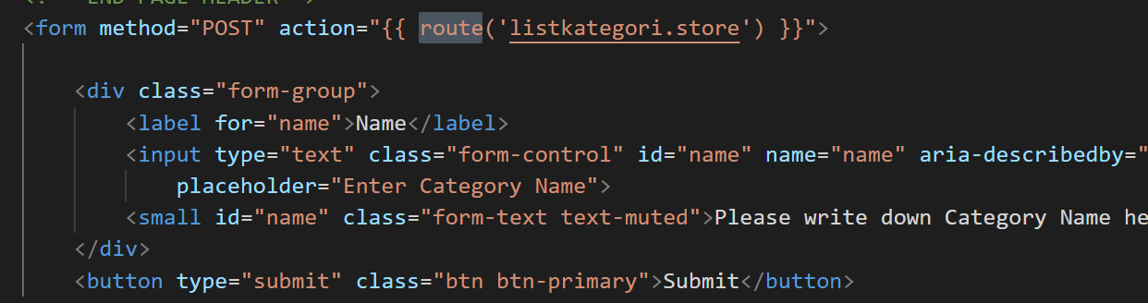
Modify : CategoryController - Store
We need to code for save data into database
Informatics Engineering | Universitas Surabaya

Slide 22

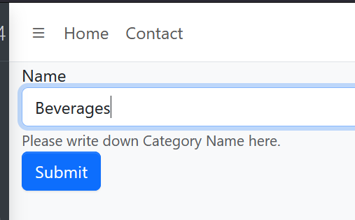
Fill and see the result
WHY ?
Informatics Engineering | Universitas Surabaya

Slide 23
Error 419
Error 419 is “a CSRF Token is missing or expired”
CSRF Token is one of the security features. It overcomes an injection of ‘Cross-Site Request Forgery’ (CSRF) Script.
(https://en.wikipedia.org/wiki/List_of_HTTP_status_codes)
Informatics Engineering | Universitas Surabaya

Slide 24
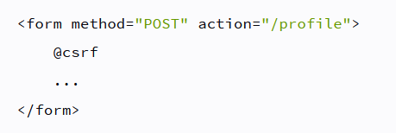
CSRF Protection
Laravel will generate a ‘token’ in each managed session
It can be done by using syntax @csrf in the request (both ajax or form) in the POST method
https://laravel.com/docs/10.x/csrf
Informatics Engineering | Universitas Surabaya

Slide 25
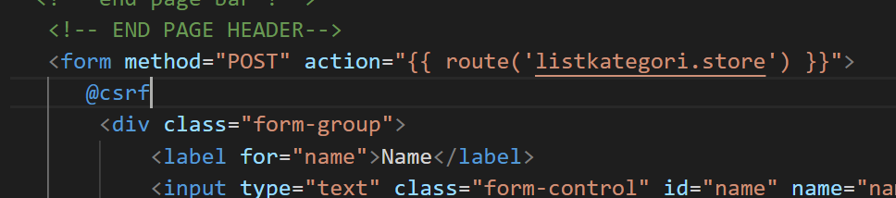
Add CSRF
In your view, add @csrf below <form>
Informatics Engineering | Universitas Surabaya

Slide 26
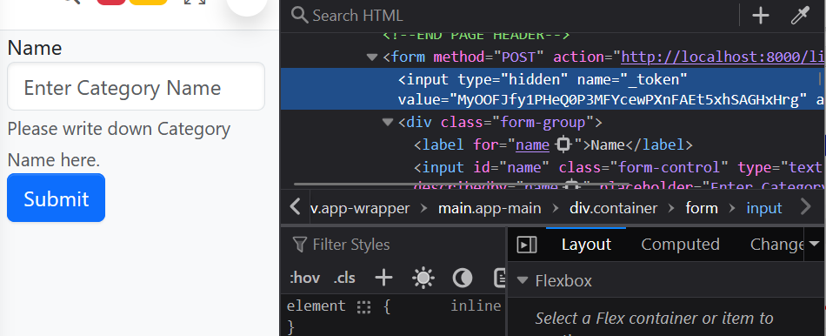
Observe – Inspect Element Browser
Informatics Engineering | Universitas Surabaya

Slide 27
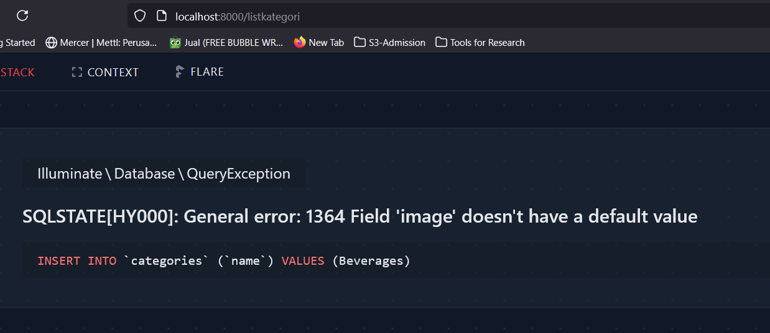
[Issue #1] There are specific required parameters that not complete

Slide 28
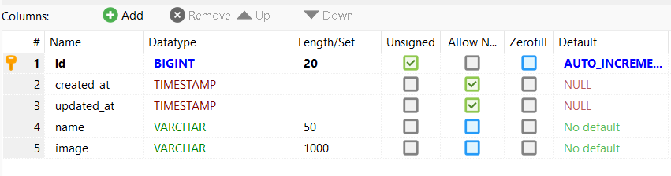
“image” column have to complete one value where you execute your new data 🡪 based on “Allow Null” and “Default value”
Solution #1:
Change specific column with NULLABLE or DEFAULT VALUE
Solution #2:
You have to encourage user to set specific value with hidden type OR explisit user input (if possible)
In this case “category”, we use “solution 1” with Default Image from storage

Slide 29
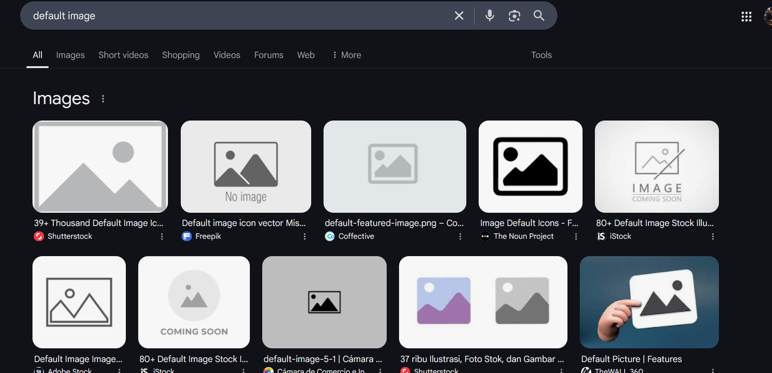
Get from open source, Google Images, Canva or your image repository

Slide 30
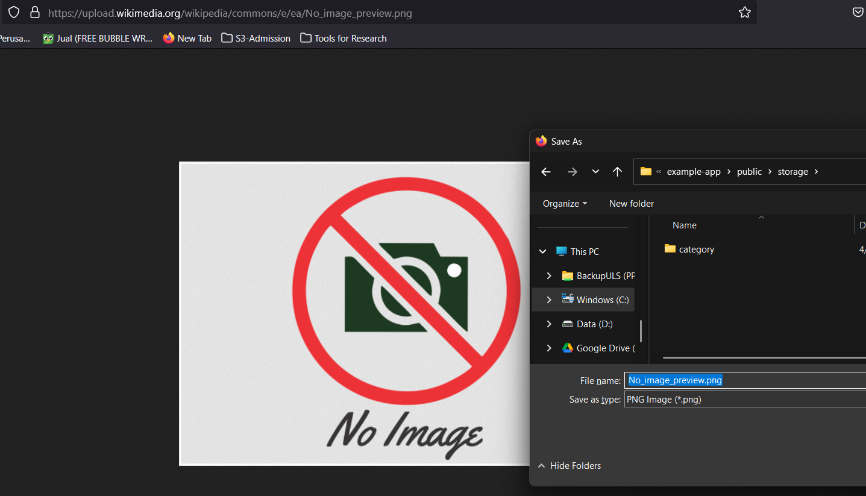
Save your image into: Laravel/public/storage/category/…….

Slide 31
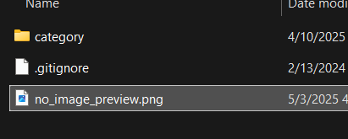
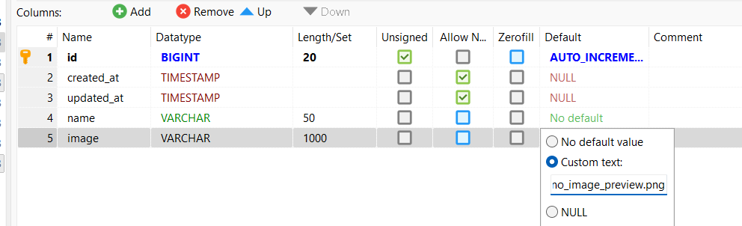
Get the filename of your image and insert into your database structure
ALTER TABLE `categories`
CHANGE COLUMN `image` `image` VARCHAR(1000) NOT NULL DEFAULT 'no_image_preview.png’;

Slide 32
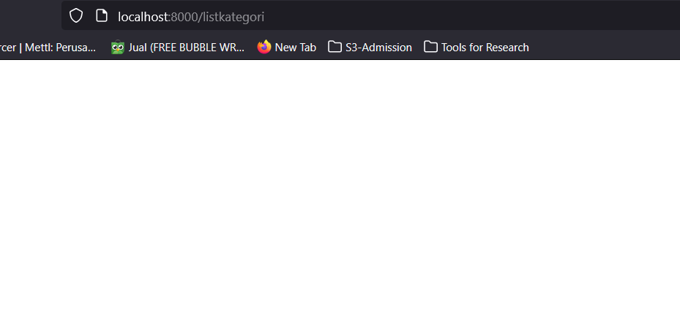
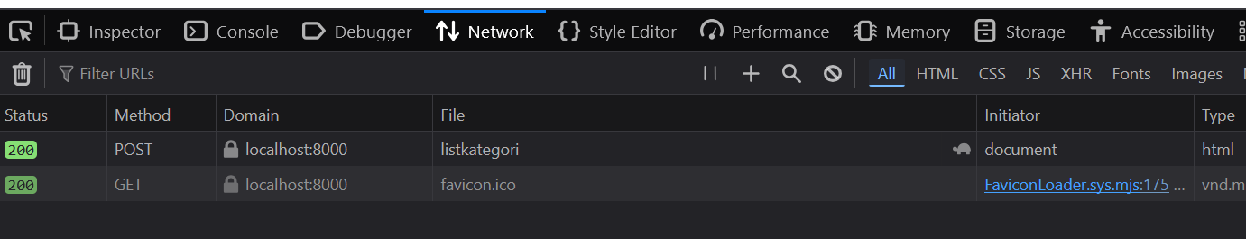
Run and Submit again
There is no error message, but it shows blank page.
Check in the type table in database.
Informatics Engineering | Universitas Surabaya

Slide 33
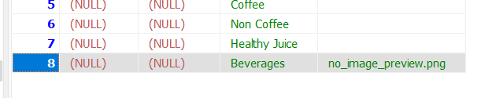
New Record was Inserted
Informatics Engineering | Universitas Surabaya

Slide 34
Exercise #3 : Confirmation
Informatics Engineering | Universitas Surabaya

Slide 35
Redirect
For confirmation, we can re-use or re-call index() function in CategoryController.
It is not recommended to make new query then returning view, because it already exists in index().
Therefore, we will use Redirect.
Informatics Engineering | Universitas Surabaya

Slide 36
Redirect Laravel
Redirect in Laravel is similar with the common Redirect function which changing a page to another page based on the URL
Redirect can be placed in the controller or action in routing file.
The advantages of redirect in laravel
Can use redirect back() to going back in page before the active page. Usually use after a validation process.
Can be redirect based on route name and can be parameterized
Can be redirect to a controller function (redirect action)
Can be redirect to another URL
Can be redirect with bringing flash message (stored in the session)
https://laravel.com/docs/10.x/responses#redirects
Informatics Engineering | Universitas Surabaya

Slide 37

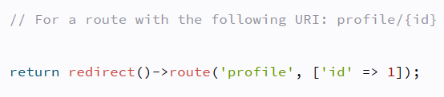
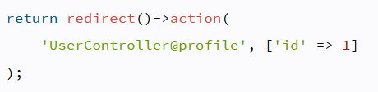
Redirect : Example Route Name & Controller
Informatics Engineering | Universitas Surabaya

Slide 38
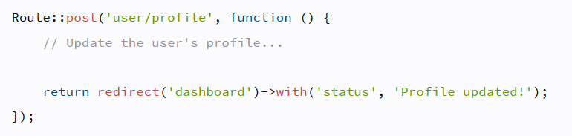
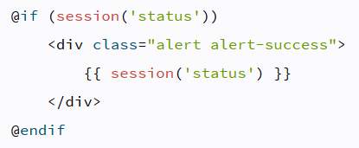
Redirect : Example with FlashData
To get “profile update!” data, it use session()
Informatics Engineering | Universitas Surabaya

Slide 39
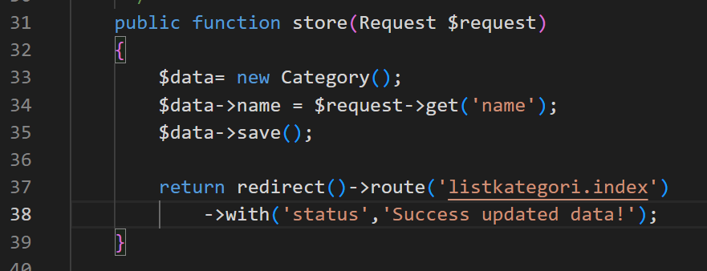
Redirect : Confirmation
Using Flash after saving data
Informatics Engineering | Universitas Surabaya

Slide 40
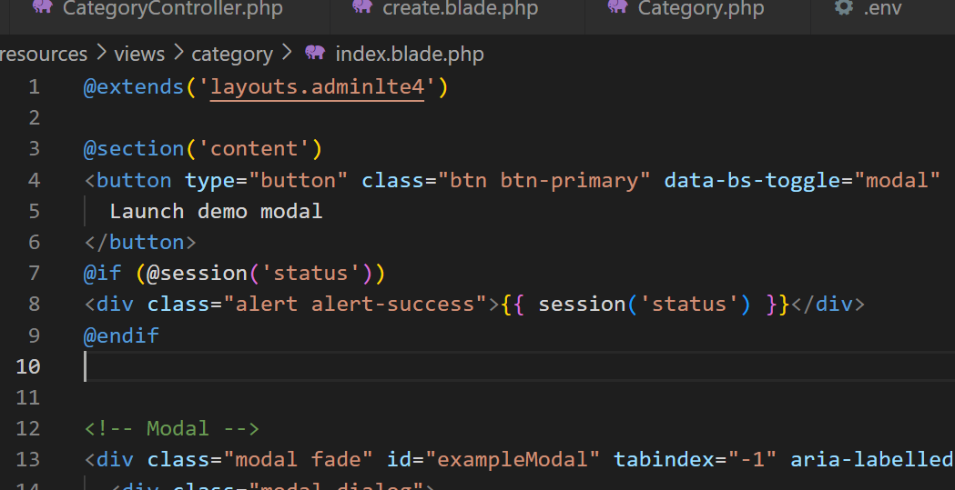
Modify your index.blade.php
Put if session before the table data and do not forget to modify index method
@extends('layouts.adminlte4')
@section('content')
@if (@session('status'))
<div class="alert alert-success">
{{ session('status') }}
</div>
@endif
<table class="table">
….
</table>
@endsection
Informatics Engineering | Universitas Surabaya

Slide 41
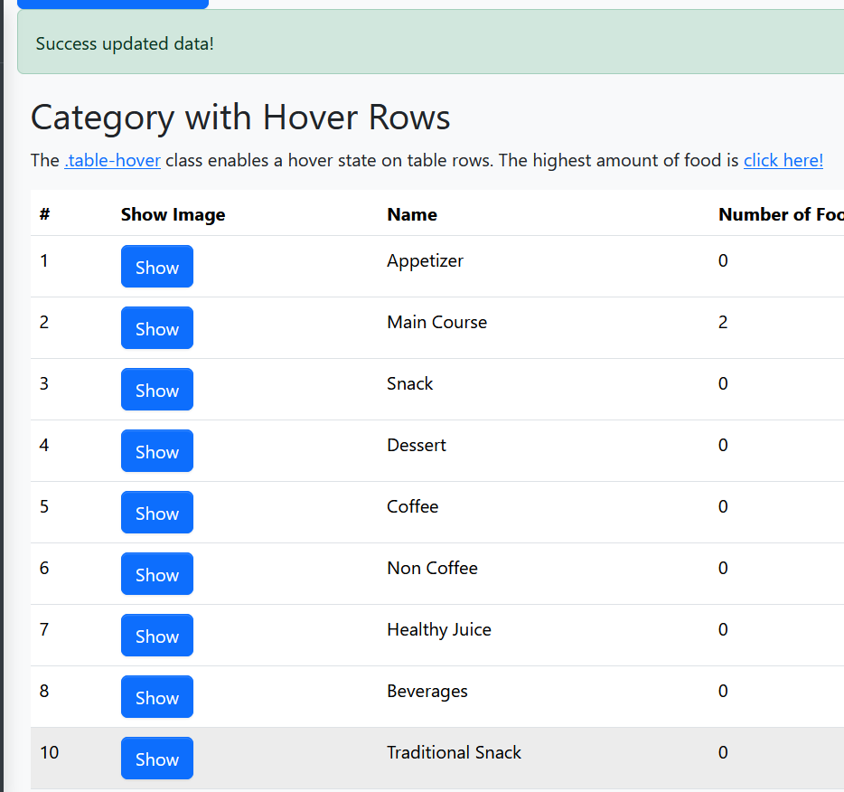
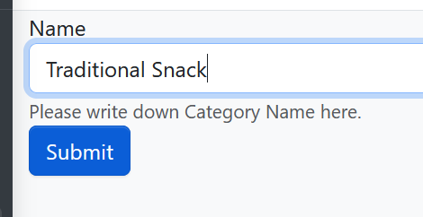
Result
Informatics Engineering | Universitas Surabaya

Slide 42
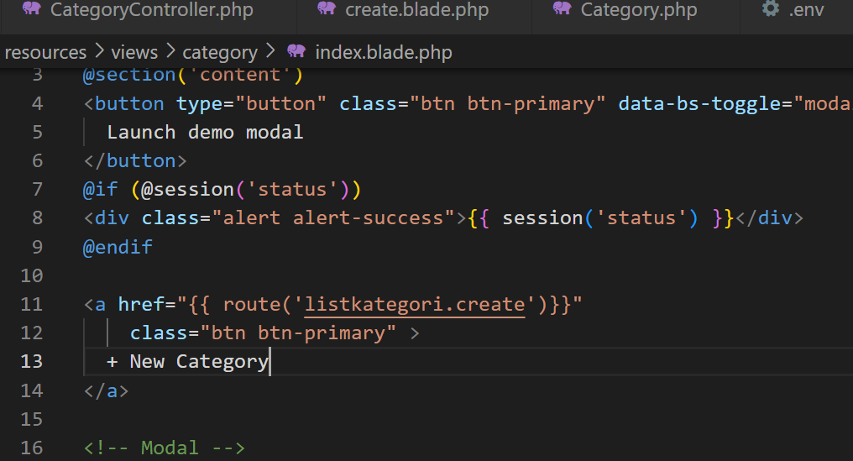
Add button : New Category
Informatics Engineering | Universitas Surabaya

Slide 43
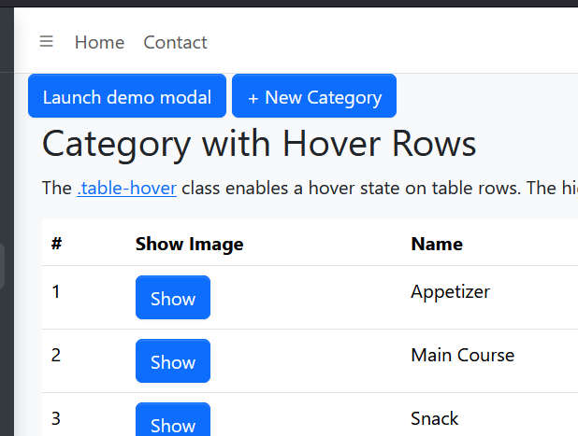
Add button : New Category (2)
Informatics Engineering | Universitas Surabaya

Slide 44
Homework
Informatics Engineering | Universitas Surabaya

Slide 45
Redirect
Until next week
Implement a submission form for new menus, and transactions / orders
In new menu Form, there are capabilities:
Use combo box for selecting the category_id (from categories table).
The value of category_id is taken from query that parsed when calling the view in create() method
In orders Form, there are capabilities :
Use combo box for selecting the menu_id and each number
Use Many to many relationship (please open https://laravel.com/docs/10.x/eloquent-relationships#many-to-many) [ https://laravel.com/docs/10.x/eloquent-relationships#attaching-detaching ]
Please submit your homework with your project
Informatics Engineering | Universitas Surabaya

Slide 46
Thanks.
Informatics Engineering | Universitas Surabaya

